Slide 1

Designing your Field module
APP NAME: your fitness
Name: Md. Adieb Siddique
Course:BCA-3
Enroll:a45304819034

Slide 2
acknowledgement
I would like to express my special thanks of gratitude to my Android Trainer “Mr. Mani Gautam” for their able guidance and support in completing my Project.
Then I would like to thank my parents and friends who helped me with their valuable suggestions and guidance has been helpful in various phases of the completion of the project.

Slide 3
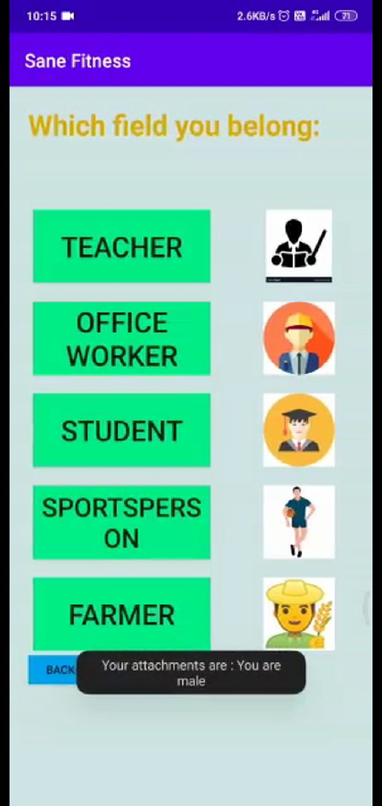
Contents
Choose Your Field page Module
Coding of field module
Integrating all modules in field page

Slide 4
Choose your field module
There are total of five fields containing in this module. The first module is of teacher, second is of an office worker ,third is for student, fourth is of a sportsperson and the last is of a farmer.
The module name buttons are provided to go to all of the modules pages for following exercises , diet and yoga made for each and every profession mentioned.
At the end there is a back button provided for going back to the front login page.

Slide 5
Coding of field module
import androidx.appcompat.app.AppCompatActivity; import android.content.Intent; import android.os.Bundle; import android.view.View; import android.widget.Button; import android.widget.ListView; import android.widget.TextView; import android.widget.Toast; import java.util.ArrayList; public class FrontPage extends AppCompatActivity implements View.OnClickListener { Button one,two,three,four,five,back; @Override protected void onCreate(Bundle savedInstanceState) { super.onCreate(savedInstanceState); setContentView(R.layout.activity_front_page); one=findViewById(R.id.btnteach); two=findViewById(R.id.btneng); three=findViewById(R.id.btnlaw); four=findViewById(R.id.btnsport); five=findViewById(R.id.btnfarm); back=findViewById(R.id.btnback0); one.setOnClickListener(this); two.setOnClickListener(this); three.setOnClickListener(this); four.setOnClickListener(this); five.setOnClickListener(this); back.setOnClickListener(this); }

Slide 6
public void onClick(View v) { switch(v.getId()) { case R.id.btnteach: { Intent callnext=new Intent(this,teacher.class); startActivity(callnext); break;} case R.id.btneng:{ Intent callnext=new Intent(this,office.class); startActivity(callnext);} break; case R.id.btnlaw:{ Intent callnext=new Intent(this,lawyer.class); startActivity(callnext);} break; case R.id.btnsport:{ Intent callnext=new Intent(this,sport.class); startActivity(callnext);} break; case R.id.btnfarm:{ Intent callnext=new Intent(this,farmer.class); startActivity(callnext);} break; case R.id.btnback0:{ Intent gotofirst=new Intent(this,MainActivity.class); startActivity(gotofirst);} break; } } }

Slide 7
Integrating all the modules
It was an interesting part where all the modules have to be integrated into a single page created by me.
The purpose for integrating all modules was giving ease of access to our users by creating a page where they can easily select and do their workouts which are good in their perspectives.

Slide 8


